Slide 1
Lecture #0
Deep Learning
(INT422)

Slide 2
Course Overview
L T P :
Credit: 3
Text Books:
DEEP LEARNING by AMIT KUMAR DAS, Pearson Education India
References Book:
ADVANCED DEEP LEARNING WITH TENSORFLOW 2 AND KERAS by ROWEL ATIENZA, PACKT PUBLISHING
2 | 0 | 2

Slide 3
Marks Breakup
Marks Breakup:
Activity | Marks
Attendance | 5
Continuous Assessment (CA)* | 25
Mid-Term Examination (MTE) | 20
End-Term Examination (ETE) | 50

Slide 4
CA and MTE
CA (C010102):
1- code based test
1- Test
1- Project (Compulsory)
MTE
100% MCQ
ETE
50% MCQ + 50% Theory

Slide 5


Slide 6
Course Objectives
describe e the deep learning algorithms which are more appropriate for various types of learning tasks in various domains.
compare detection and recognition tasks using convolution and adversarial neural networks.
use dropout regularization, gradient descent, Batch normalization, and optimization algorithms with convergence.
examine recurrent neural networks for modelling sequential data.
assess the different learning models and prioritize their appropriate hyper parameters.
construct artificial neural networks with Tensorflow and Keras.

Slide 7
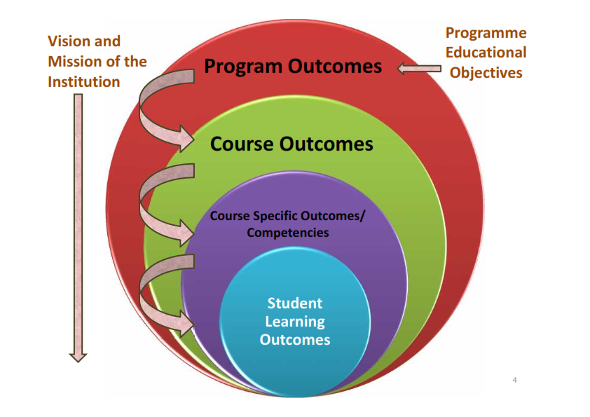
Program Outcomes
PO-1 Engineering knowledge::Apply the knowledge of mathematics, science, engineering fundamentals, and an engineering specialization to the solution of complex engineering problems.
PO-2 Problem analysis::Identify, formulate, research literature, and analyze complex engineering problems reaching substantiated conclusions using first principles of mathematics, natural sciences, and engineering sciences.

Slide 8
Program outcomes
PO-3 Design/development of solutions::Design solutions for complex engineering problems and design system components or processes that meet the specified needs with appropriate consideration for the public health and safety, and the cultural, societal, and environmental considerations.
PO-6 The engineer and society::Apply reasoning informed by the contextual knowledge to assess societal, health, safety, legal and cultural issues and the consequent responsibilities relevant to the professional engineering practice.
PO-12 Life-long learning::Recognize the need for, and have the preparation and ability to engage in independent and life-long learning in the broadest context of technological change.
PO-13 Competitive Skills::Ability to compete in national and international technical events and building the competitive spirit

Slide 9

Revised Bloom’s taxonomy (RBT)

Slide 10
What are Cohorts
A group of students of a common programme who intend to attain similar characteristics by means of learning similar skills in order to target a particular career opportunity.

Slide 11
Purpose of Cohorts
Student shall be able to have a goal oriented approach for his/her career
Student identifies the goal in the very first year
Student shall be able to follow the stage wise career progression.
Early identification of skill set required for selected goal.

Slide 12
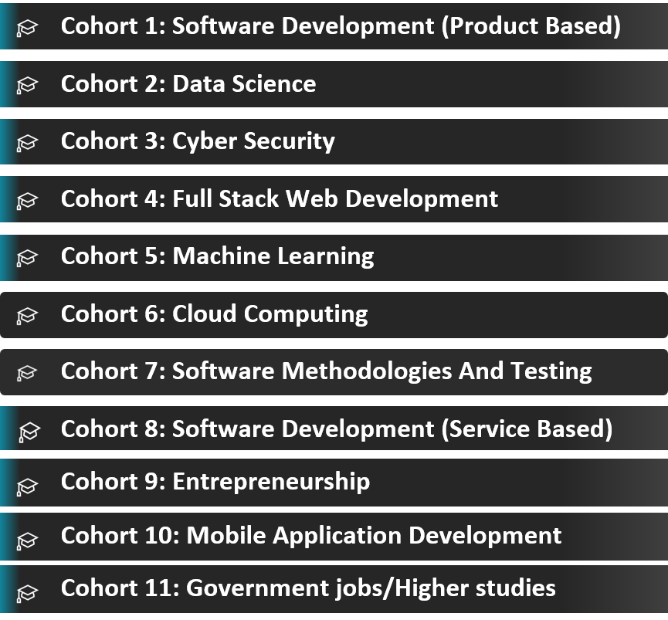
INT422 – Cohort 5

Slide 13
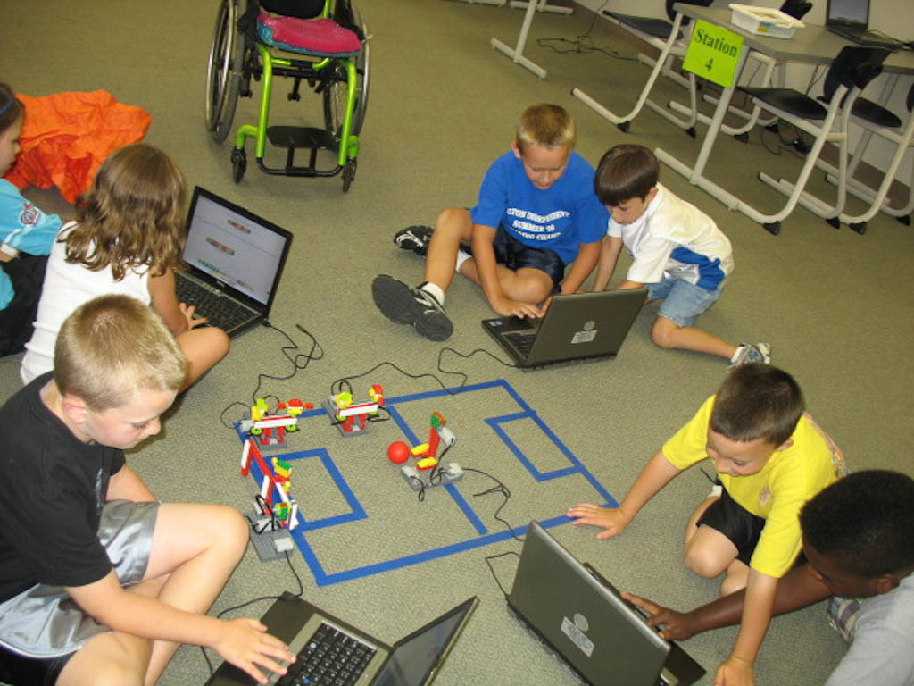
Application
Entertainment

Slide 14
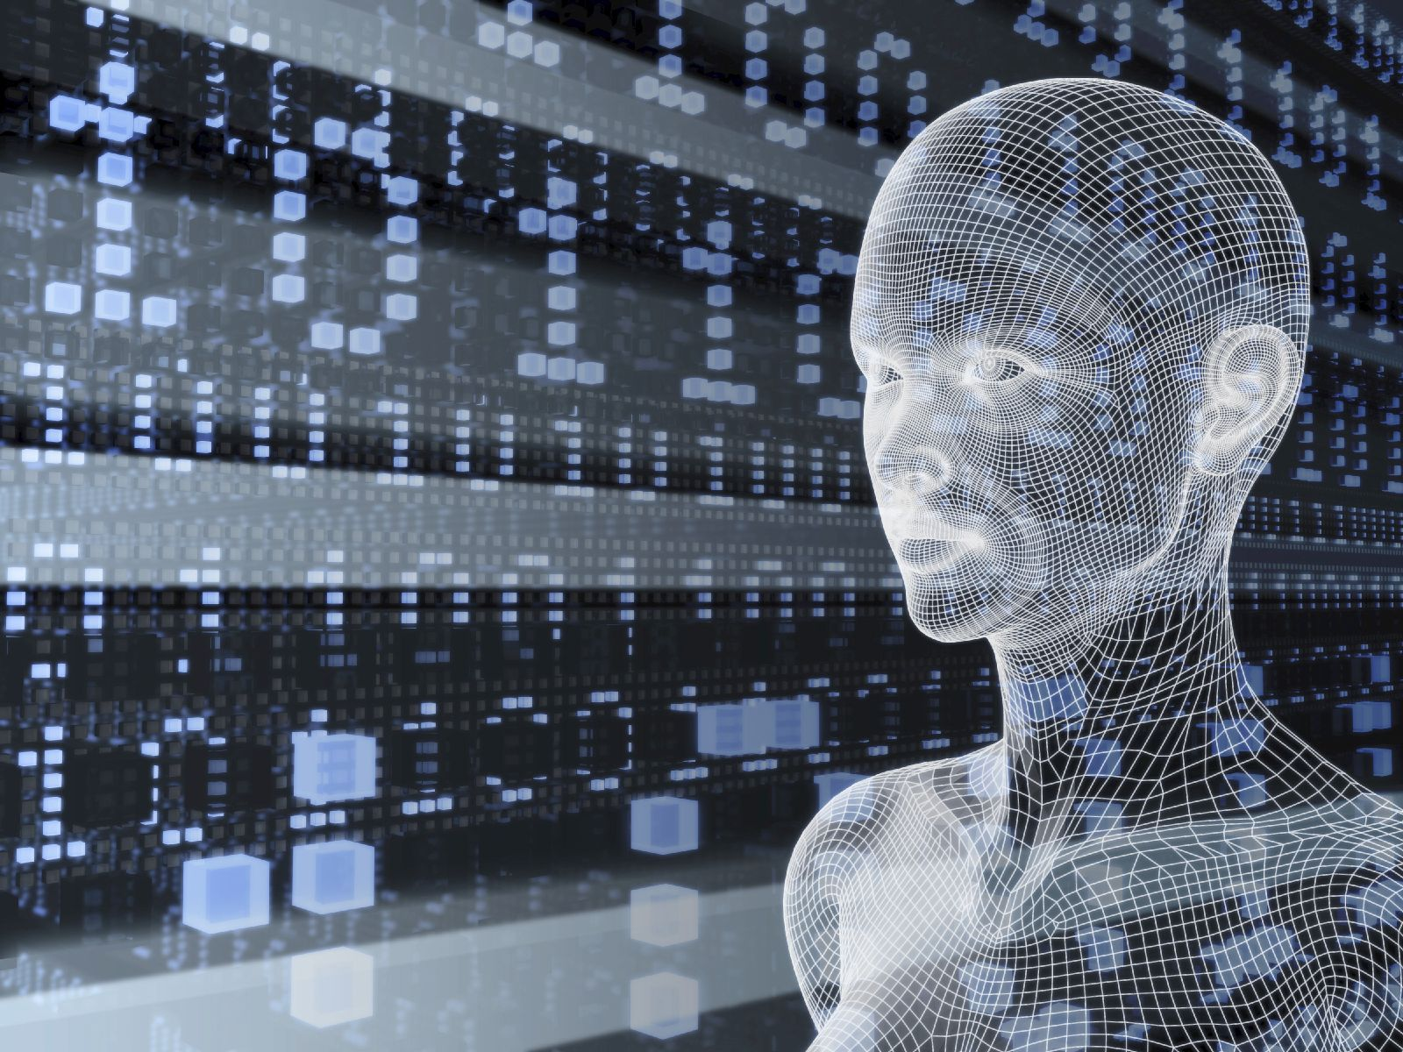
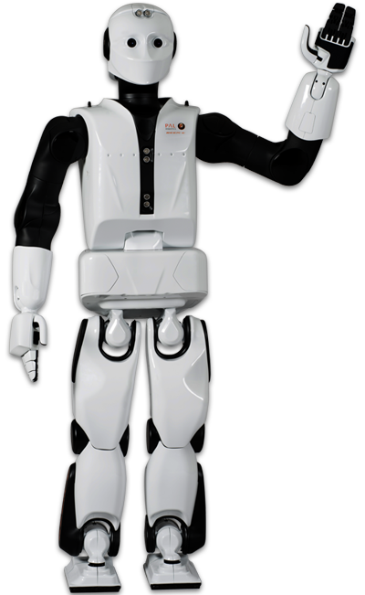
Application
Intelligent Robots

Slide 15
Unit1
Building Models with TensorFlow : Introduction to TensorFlow, Installation of TensorFlow, TensorFlow ranks and tensors, TensorFlow's computation graphs, variables in TensorFlow, TensorFlow optimizers, transforming tensors as multidimensional data arrays, visualization with Tensorboard, Introduction of Deep Learning, Applications of Deep Learning

Slide 16
Unit2
Building Models with Keras : Introduction to keras, Keras installation, keras layers and models, building a regression model, image classification with keras, multi-layer Perceptron learning for classification, building text classification model, overfit and underfit, save and load model, hyperparameter tuning

Slide 17
Unit3
Classifying images with deep convolutional neural networks : building blocks of convolutional neural networks, determining the size of the convolution output, performing a discrete convolution in 2D, subsampling, putting everything together to build a CNN, implementing a deep convolutional neural network using TensorFlow, Transfer learning with pre-trained CNN, data augmentation, image segmentation

Slide 18
Unit4
Autoencoders and Pre-trained CNN : introduction to autoencoders, need for autoencoders, architecture of autoencoder, properties and hyperparameter, types of autoencoders, data compression using autoencoders, variational autoencoders

Slide 19
Unit5
Modeling sequential data using recurrent neural networks : modeling sequential data, understanding the structure and flow of an RNN, computing activation in an RNN, challenges of learning long-range interactions, implementing a multilayer RNN for sequence modeling in TensorFlow, text classification with an RNN, text generation with an RNN, time series forecasting, LSTM units, sequence classification with LSTM, stacked LSTM for sequence classification

Slide 20
Unit6
Generative Adversarial Networks : introduction to generative models, overview of GAN structure, discriminator, generator, building GAN, problems with GANs, CycleGAN, Adversarial FGSM

Slide 21
Audio Visual Aids
1. https://scs.hosted.panopto.com/Panopto/Pages/Viewer.aspx?id=ad6574d4-b695-4940-
8449-2e09096ed16c
2. https://scs.hosted.panopto.com/Panopto/Pages/Viewer.aspx?id=a8eedb53-a516-4e58-
99fe-768361da9bf4

Slide 22
Journals articles
http://link.springer.com/search?query=&search-within=Journal&facet-journal-id=10994&package=openaccessarticles
http://www.jmlr.org/papers/
http://www.cs.cmu.edu/~tom/10701_sp11/slides/DTreesAndOverfitting-1-11-2011_final.pdf
http://www.cs.cmu.edu/~tom/10701_sp11/slides/MLE_MAP_1-18-11-ann.pdf ,
http://www.cs.cmu.edu/~tom/10701_sp11/slides/PAC-learning1-2-24-2011-ann.pdf

Slide 23
Next Class:
learning with ensembles

Slide 24


